Slide 1

Portfolio Milestone
By: Matthew Laken
Spring 2022

Slide 2

Who Am I?
Undergraduate
Graduate of University of Maryland, College Park School of Information Studies, Bachelor of Science in Information Science, May 2020.
Masters
Enrolled in Syracuse University Master of Applied Data Science Program, Fall 2020.
Completion of Master of Applied Data Science Program, Spring 2022.
Objective
Expand the application for information and data science by digging deeper.
Notes:
I graduated from the university of Maryland college park with my bachelors of science in information science in the Spring of 2020
I then enrolled in the Masters of Applied Data Science program in the Fall of 2020 at Syracuse University
My objective is to expand the applications of information and data science by digging deeper and continuously asking questions.

Slide 3




My Course Highlights:
IST 659: Database Administration
IST 687: Introduction to Data Science
IST 707: Data Analytics
IST:652 Scripting for Data Analysis

Slide 4

IST 659: Database Administration
Goal: Fundamentals of databases; compiling datasets, building tables, writing queries and storing models.
Professor: Chad Harper
Date: Fall 2020
Software: Microsoft SQL, Access, Excel, R (R Studio)
Notes:
Objectives:
To begin the first course I took in this program was IST 659 Database administration. The goal of this course is to understand the fundamentals of databases, compiling databases, building tables, writing queries, and storing models.
This course was taught to me by Professor Chad Harper in the Fall of 2020.
The software focus was Microsoft SQL, Access, Excel, R and Rstudio
Describe fundamental data and database concepts including various storage models.
Explain and use the database development lifecycle and data models.
Analyze business problems and design and implement appropriate data-oriented solutions using the relational data storage model.
Solve problems by constructing database objects and queries using the SQL language.
Identify performance and data integrity improvements of existing database designs and implementations.
Evaluate and select approaches for data migrations, temporal data, and data normalization.
Critique the effectiveness of DBMS in computer information systems.

Slide 5
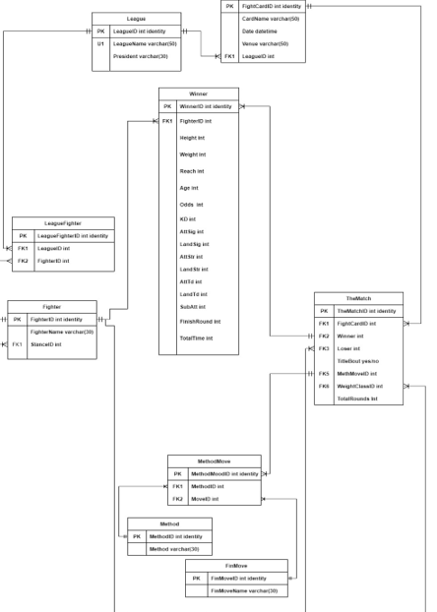

UFC Relational Database
Purpose: Develop a logical relational database to store information on UFC fighters and results of their matches to gain insight on the sport.
Data Source: http://ufcstats.com/
Deliverable: Comprehensive report including the logical model of the database, questions, views/functions and evaluation.
The purpose of my database is to create a predictive model to be applied for sports with an individual competitor, for this assignment, I am focusing on the UFC.
I have generated a relational database that contains the UFC roster as well as all fight cards tracing back a certain period of time. My intentions are for one to be able to utilize this database to make informed decisions on the result of an upcoming match based on a fighter’s history and the history of the league. The fighter data is broken down by weight class and fights will be tracked by card.
I collected my data from the official UFC stats website Into tables then put together a report focusing on specific questions answered uaing views and functions I created in SQL.
Notes:
The purpose of my database is to create a predictive model to be applied for sports with an individual competitor, for this assignment, I am focusing on the UFC. I have generated a relational database that contains the UFC roster as well as all fight cards tracing back a certain period of time. My intentions are for one to be able to utilize this database to make informed decisions on the result of an upcoming match based on a fighter’s history and the history of the UFC. The fighter data is broken down by weight class and fights will be tracked by card.
I found my data from the official UFC stats website then put together a report focusing on specific questions answered uaing views and functions I created in SQL.
Objectives:
Describe fundamental data and database concepts including various storage models.
Explain and use the database development lifecycle and data models.
Analyze business problems and design and implement appropriate data-oriented solutions using the relational data storage model.
Solve problems by constructing database objects and queries using the SQL language.
Identify performance and data integrity improvements of existing database designs and implementations.
Evaluate and select approaches for data migrations, temporal data, and data normalization.
Critique the effectiveness of DBMS in computer information systems.

Slide 6
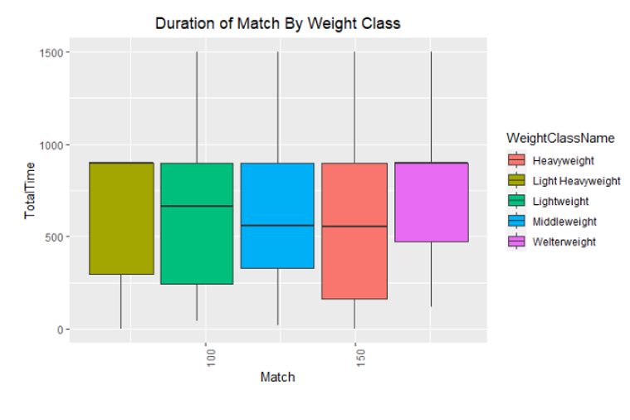
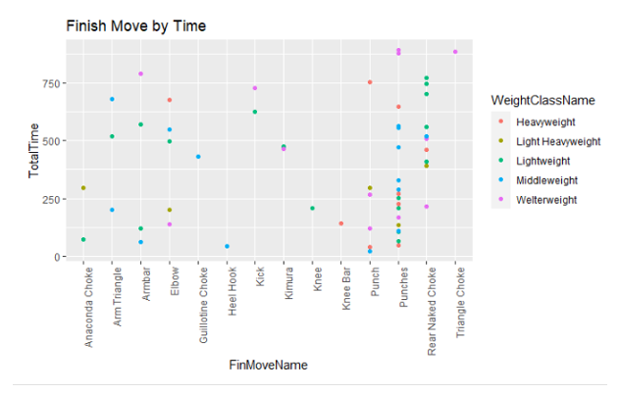
Analysis
Aggregated data by Weight Class:
Analyzed aspects of the match to observe the differences between the different divisions.
Concluded the following:
Heavyweight matches end earlier than others, and they throw fewer strikes compared to other divisions.
Majority of fights that are stopped early result in the winner by punches.
Nexr, I called in my database to rstudio and Aggregated data by Weight Class
This allowed me to anlalyze aspects of the match to observe the differences between divisions
I utilized visualization packages in rstudio to generate box and scatter plots which illustrate the differences across weight classes
I concluded the following
Heavyweight matches end earlier than others, and they throw fewer strikes compared to other divisions
Notes:
Objectives:
Describe fundamental data and database concepts including various storage models.
Explain and use the database development lifecycle and data models.
Analyze business problems and design and implement appropriate data-oriented solutions using the relational data storage model.
Solve problems by constructing database objects and queries using the SQL language.
Identify performance and data integrity improvements of existing database designs and implementations.
Evaluate and select approaches for data migrations, temporal data, and data normalization.
Critique the effectiveness of DBMS in computer information systems.

Slide 7

Learning Outcomes
Collect and clean data / develop a database.
Understand database development lifecycle.
Construct analyze and solve business problems by using SQL language to create and run queries.
Enforce integrity of data / database through database design and implementation.
By completing this course, I now know how to Collect and clean data.
I Understand the database development lifecycle and have gone through the steps in their entirety.
I demonstrated the ability to Construct. analyze and solve business problems by using SQL language to create and run queries.
And lastly, I know how to and understand how to Enforce the integrity of a database through design and implementation.
Notes:
Objectives:
Describe fundamental data and database concepts including various storage models.
Explain and use the database development lifecycle and data models.
Analyze business problems and design and implement appropriate data-oriented solutions using the relational data storage model.
Solve problems by constructing database objects and queries using the SQL language.
Identify performance and data integrity improvements of existing database designs and implementations.
Evaluate and select approaches for data migrations, temporal data, and data normalization.
Critique the effectiveness of DBMS in computer information systems.

Slide 8

IST 687: Introduction to Data Science
Goal: Exploring the key components of data science by expanding on knowledge of spreadsheets to utilize R to answer business problems.
Professor: Jeffery Saltz / Tin Hoang
Date: Fall 2020
Software: R (R Studio), Microsoft Excel
Notes:
Understand essential concepts and characteristics of data.
Understand scripting/code development for data management using R and R-Studio.
Understand principles and practices in data screening, cleaning, and linking.
Understand communication of results to decision makers.
Identify a problem and the data needed for addressing the problem.
Perform basic computational scripting using R and other optional tools.
Transform data through processing, linking, aggregation, summarization, and searching.
Organize and manage data at various stages of a project life-cycle.
Determine appropriate techniques for analyzing data.

Slide 9

Project: Analysis of Cost and Salary Potential of Attending College
Purpose: Analyze the cost of going to college and one's salary potential upon graduating to determine the most cost beneficial schools to attend.
Data Source: https://www.kaggle.com/jessemostipak/college-tuition-diversity-and-pay?select=salary_potential.csv
Deliverable: Comprehensive report including methods of analysis and evaluation.
Notes:
The Introduction to Data Science course final project challenged students to generate a thorough business presentation on a collection of data of their choosing while working in a team.
For my group project, we analyzed a Kaggle dataset on college tuition cost across the United States and the average starting salaries upon earning a degree.
We investigated the Cost and Salary Potential of Attending College. We utilized a basic linear model as well as a Kernel Support Vector Machine to determine which is superior in finding an expected value for mid-career salary when comparing the errors for the two models. Both models consider the values for each school’s total price and early-career salary. We communicate our analysis throughout various tables and visualizations.
The Introduction to Data Science course final project challenged students to generate a thorough business presentation on a collection of data of their choosing while working in a team.
For my group project, we analyzed a Kaggle dataset on college tuition cost across the United States and the average starting salaries upon earning a degree.
We investigated the Cost and Salary Potential of Attending College. We utilized a basic linear model as well as a Kernel Support Vector Machine to determine which is superior in finding an expected value for mid-career salary when comparing the errors for the two models. Both models consider the values for each school’s total price and early-career salary. We communicate our analysis throughout various tables and visualizations.
Objectives:
Understand essential concepts and characteristics of data.
Understand scripting/code development for data management using R and R-Studio.
Understand principles and practices in data screening, cleaning, and linking.
Understand communication of results to decision makers.
Identify a problem and the data needed for addressing the problem.
Perform basic computational scripting using R and other optional tools.
Transform data through processing, linking, aggregation, summarization, and searching.
Organize and manage data at various stages of a project life-cycle.
Determine appropriate techniques for analyzing data.

Slide 10
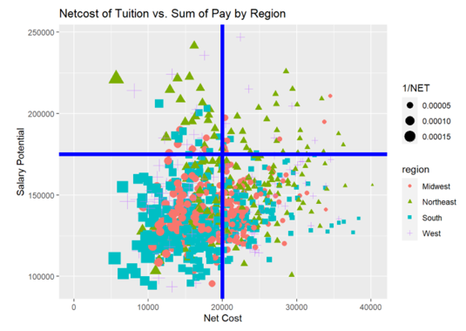
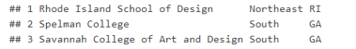
Analysis
Ability to determine which schools have the lowest cost and the greatest potential for salary.
Notes:
This project was done in R Studio using R packages such as dplyr to aggregate the data by region, for example, and ggplot to visualize it.
We found the mean values of the cost of tuition, financial aid, and salary after grouping the university data by region. This allowed us to see which part of the country provides students with the best value for their degree shown in the table.
This project was done in R Studio using R packages such as dplyr to aggregate the data by region, for example, and ggplot to visualize it.
We found the mean values of the cost of tuition, financial aid, and salary after grouping the university data by region. This allowed us to see which part of the country provides students with the best value for their degree shown in the table.
Objectives:
We utilized a basic linear model as well as a Kernel Support Vector Machine to determine which is superior in finding an expected value for mid-career salary when comparing the errors for the two models. Both models consider the values for each school’s total price and early-career salary.
Comparing the plot of errors from both models, we can see that the KVSM model tracks closer to the true data than the linear model. Both models have about the same overall error with -0.08% for the linear model and -0.07% for the KVSM. The linear model has a wider range of error (-9%,10%) compared to the KSVM values (-7%,5%). The narrower range of error makes the KVSM more accurate, but the linear model runs much faster, seconds compared to about ten minutes. Depending on the relative importance of speed and accuracy to a user, either model seems sufficient to predict mid-career salary.
Understand essential concepts and characteristics of data.
Understand scripting/code development for data management using R and R-Studio.
Understand principles and practices in data screening, cleaning, and linking.
Understand communication of results to decision makers.
Identify a problem and the data needed for addressing the problem.
Perform basic computational scripting using R and other optional tools.
Transform data through processing, linking, aggregation, summarization, and searching.
Organize and manage data at various stages of a project life-cycle.
Determine appropriate techniques for analyzing data.

Slide 11
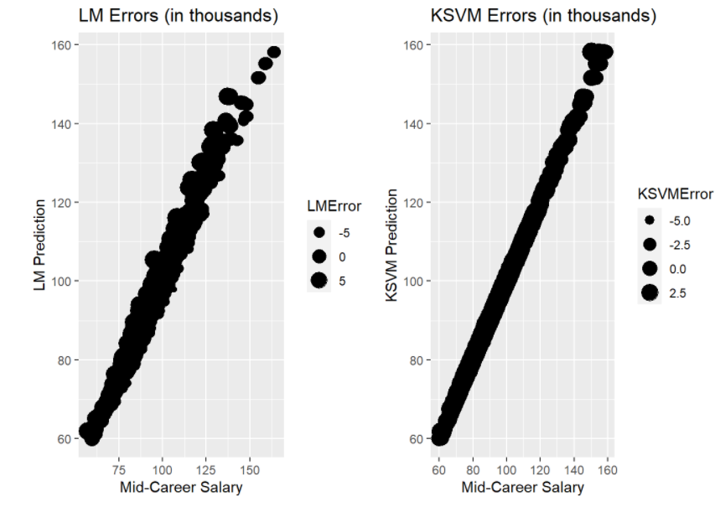
Analysis
Can we predict the mid salary career based on where they go to school?
KSVM model tracks closer to the true data than the linear model.
Both models have about the same overall error.
The narrower range of error makes the KSVM more accurate, but the linear model runs much faster.
Either model seems sufficient to predict mid-career salary.
Notes:
We utilized a basic linear model as well as a Kernel Support Vector Machine to determine which is superior in finding an expected value for mid-career salary by comparing the errors for the two models.
we can see that the KSVM model tracks closer to the true data than the linear model.
The linear model has a wider range of error compared to the KSVM values
This means the KSVM more accurate, but the linear model runs much faster
Depending on the relative importance of speed and accuracy to a user, either model seems sufficient to predict mid-career salary.
Objectives:
We utilized a basic linear model as well as a Kernel Support Vector Machine to determine which is superior in finding an expected value for mid-career salary when comparing the errors for the two models. Both models consider the values for each school’s total price and early-career salary.
This project was done in R Studio using R packages such as dplyr to aggregate the data by region, for example, and ggplot to visualize it. We found the mean values of the cost of tuition, financial aid, and salary after grouping the university data by region. This allowed us to see which part of the country provides students with the best value for their degree shown
Comparing the plot of errors from both models, we can see that the KVSM model tracks closer to the true data than the linear model. Both models have about the same overall error with -0.08% for the linear model and -0.07% for the KVSM. The linear model has a wider range of error (-9%,10%) compared to the KSVM values (-7%,5%). The narrower range of error makes the KVSM more accurate, but the linear model runs much faster, seconds compared to about ten minutes. Depending on the relative importance of speed and accuracy to a user, either model seems sufficient to predict mid-career salary.
Understand essential concepts and characteristics of data.
Understand scripting/code development for data management using R and R-Studio.
Understand principles and practices in data screening, cleaning, and linking.
Understand communication of results to decision makers.
Identify a problem and the data needed for addressing the problem.
Perform basic computational scripting using R and other optional tools.
Transform data through processing, linking, aggregation, summarization, and searching.
Organize and manage data at various stages of a project life-cycle.
Determine appropriate techniques for analyzing data.

Slide 12

Learning Outcomes
Fundamentals of data management using R and R-Studio such as data processing, cleaning and merging.
Identify a problem and the components needed for analyzing and communicating results.
Collaborate within a team setting to walk through the various stages of a project life-cycle and carry out a finalized product.
Determine appropriate techniques for analyzing data.
Notes:
The assignments and projects in this course provided knowledge of how to take high level problems that one would encounter in the workplace and develop a plan of action in terms of analyzing, visualizing, and applying appropriate techniques for the conditions of the problem.
This course reviewed the essential principles of data science while utilizing R and R-Studio to write code and collaborate with others through each step of the lifecycle
Objectives:
The Introduction to Data Science course reviewed the essential concepts of data science while utilizing R and R-Studio to write code to solve the course assignments. From a statistical perspective, this course encourages students to identify problems as well as the data and methods needed to investigate the problem. Students were taught to clean and configure datasets through the processes of data transformation such as aggregation, then determine which methods of analysis were best to utilize in solving specific problems
The assignments and projects in this course provided knowledge of how to take high level problems that one would encounter in the workplace and develop a plan of action in terms of analyzing, visualizing, and applying statistical models like the linear or KSVM models depending on the conditions of the problem. It is important to know how to take a project through its lifecycle, thus being able to conduct a proper investigation with modeling and interpretation is something that will be utilized in my future work.
Understand essential concepts and characteristics of data.
Understand scripting/code development for data management using R and R-Studio.
Understand principles and practices in data screening, cleaning, and linking.
Understand communication of results to decision makers.
Identify a problem and the data needed for addressing the problem.
Perform basic computational scripting using R and other optional tools.
Transform data through processing, linking, aggregation, summarization, and searching.
Organize and manage data at various stages of a project life-cycle.
Determine appropriate techniques for analyzing data.

Slide 13

IST 707: Data Analytics
Goal: Utilize the tools and methods of data mining while introducing its real-world application to solving problems in business.
Professor: Stephen Wallace
Date: Spring 2021
Software: R (R Studio), Weka, Orange, Alteryx, Excel
Notes:
Document, analyze, and translate data mining needs into technical designs and
solutions.
• Apply data mining concepts, algorithms, and evaluation methods to real-world
problems.
• Employ data storytelling and dive into the data, find useful patterns, and
articulate what patterns have been found, how they are found, and why they are
valuable and trustworthy.
Introduction to data mining techniques, familiarity with particular realworld
applications, challenges involved in these applications, and future directions of the
field. Hands-on experience with open-source software packages.

Slide 14

Project: Marvel vs D.C. Analysis
Purpose: Experiment with various classification methods by comparison, analyzing data on Superheroes and Villains from Marvel and D.C Comics.
Data Source: https://www.kaggle.com/dannielr/marvel-superheroes
Deliverable: Comprehensive report detailing the methods, proposed questions, and results of the experiment.
The Purpose of my final project was to Experiment with various classification methods by comparison, I chose to analyze data on Superheroes and Villains from Marvel and D.C comics.
Using multiple datasets from Kaggle on the characters, I associated the classification models to predict wether a character was from Marvel or D.C. as well as their alignment (good vs. evil). The algorithms I utilized were Random Forest, Naïve Bayes, kNN, and SVM.
Notes:
Tackle the age old question of Marvel vs DC by Demonstrate an understanding of classification methods by tac Superheroes and Villains.
Document, analyze, and translate data mining needs into technical designs and
solutions.
• Apply data mining concepts, algorithms, and evaluation methods to real-world
problems.
• Employ data storytelling and dive into the data, find useful patterns, and
articulate what patterns have been found, how they are found, and why they are
valuable and trustworthy.
Introduction to data mining techniques, familiarity with particular realworld
applications, challenges involved in these applications, and future directions of the
field. Hands-on experience with open-source software packages.

Slide 15
Analysis
Using SVM, kNN, Random Forest and Naïve Bayes to determine which model is most accurate in classifying the characters.
3-fold cross validation to determine how they can predict publisher and alignment for the power dataset, the rating statistics dataset, and the combined dataset.
SVM algorithm yielded the greatest percent of classification accuracy.
Experiment | SVM CA
Experiment 5: Predict Publisher with Master Dataset | 69.1%
Experiment 6: Predict Alignment with Master Dataset | 68.2%
Notes:
I conducted a 3-fold cross validation to determine how each experiment can predict publisher and alignment for the power dataset, the rating statistics dataset, and the combined dataset.
With that said our classification accuracy tells us that the SVM algorithm is most effective when predicting the publisher, Marvel or DC, using both the Power and Score data.
This proves that the most enhanced dataset yields the most accurate results.
I conducted a 3-fold cross validation to determine how each experiment can predict publisher and alignment for the power dataset, the rating statistics dataset, and the combined dataset.
With that said our classification accuracy tells us that the SVM algorithm is most effective when predicting the publisher, Marvel or DC, using both the Power and Score data.
This proves that the most enhanced dataset yields the most accurate results.
I conducted a 3-fold cross validation to determine how each experiment can predict publisher and alignment for the power dataset, the rating statistics dataset, and the combined dataset.
With that said our classification accuracy tells us that the SVM algorithm is most effective when predicting the publisher, Marvel or DC, using both the Power and Score data.
This proves that the most enhanced dataset yields the most accurate results.
In comparing the various classification algorithms and their accuracy in predicting both Publisher and Alignment, Naïve Bayes has proven to be least effective in working with all three datasets.
3-fold cross validation to determine how they can predict publisher and alignment for the power dataset, the rating statistics dataset, and the combined dataset.
With that said our classification accuracy tells us that the SVM algorithm is most effective when predicting the publisher, Marvel or DC, using both the Power and Score data.
Document, analyze, and translate data mining needs into technical designs and
solutions.
• Apply data mining concepts, algorithms, and evaluation methods to real-world
problems.
• Employ data storytelling and dive into the data, find useful patterns, and
articulate what patterns have been found, how they are found, and why they are
valuable and trustworthy.
Introduction to data mining techniques, familiarity with particular realworld
applications, challenges involved in these applications, and future directions of the
field. Hands-on experience with open-source software packages.

Slide 16


Learning Outcomes
Document, analyze, and translate data mining needs into technical designs and solutions.
Apply data mining concepts, algorithms, and evaluation methods to real-world problems.
Employ data storytelling and dive into the data, find useful patterns, and articulate what patterns have been found, how they are found, and why they are valuable and trustworthy.
Notes:
The Data Analytics Course, IST 707, was essential in developing the skills needed to be a data storyteller in the real world as we learned how to develop solutions to our datamining Problems.
It is imperative that one be able to effectively gather datasets as exemplified in the preliminary steps of the final project to conduct an analysis.
More importantly, knowing the factors which are needed to adopt specific strategies and what is appropriate to utilize for a given project is essential to carrying out an agenda which is crucial to supporting business decisions in a professional manner.
Introduction to data mining techniques, familiarity with particular realworld
applications, challenges involved in these applications, and future directions of the
field. Hands-on experience with open-source software packages.

Slide 17

IST 652: Scripting for Data Analysis
Goal: Comprehend the tools and skills of scripting to utilize data science while solving real-world problems by analysis or visualization.
Professor: Dr. Debbie Landowski
Date: Summer 2021
Software: Python, Excel
Notes:
The main content focus is on information access and processing tasks on the types of structured, semistructured, and unstructured data in current use in information applications.
The skills learned in this class are intended to further previous knowledge in both methodology and the scripting language Python
The main content focus is on information access and processing tasks on the types of structured, semistructured, and unstructured data in current use in information applications.
The skills learned in this class are intended to further previous knowledge in both methodology and the scripting language Python For these three types of data, the course includes the use of structured numeric and text data such as that from a spreadsheet or database, the use of data obtained through standard data exchange formats such as HTML or XML from web pages or JSON from web-based APIs, and the use of data obtained by pattern matching from text or log files. The scripting language Python was chosen because of its ease of use and available packages to work with data in many information applications
Write scripts to access and amass information from files of structured data, access files in semi-structured data, and to define and find patterns in unstructured data.
Prepare and transform data to produce data summaries, lists, and networks.
Analyze and solve data access problems for the three types of data and to find and deploy appropriate software packages that can be integrated into the problem solution.
Frame real world data questions and show how they can be answered with data.

Slide 18

Project: MLB Strikeout Investigation
Purpose: Collaborate with peer to write Python scripts to
investigate data and communicate findings utilizing the techniques for processing data. This is demonstrated using baseball metrics from the pybaseball package analyzing strikeouts throughout history.
Data Source: https://pypi.org/project/pybaseball/
Deliverable: Comprehensive report detailing an initial plan for the group project. Complete with the demonstration of written Python scripts to access, prepare and use data to produce data summaries, lists, and other structures.
Notes:
The Purpose of this final project is to Collaborate with peer to write Python scripts to investigate data and communicate findings utilizing the techniques discussed in the course
My group demonstrates this using baseball metrics from the pybaseball package analyzing strikeouts throughout history.
The pybaseball package reference can be found on pypi.org and contains a plethora of baseball data .
We prepared a report detailing an initial plan for the project complete with the demonstration of written Python scripts to access, prepare and use data in our analysis of baseball data.

Slide 19
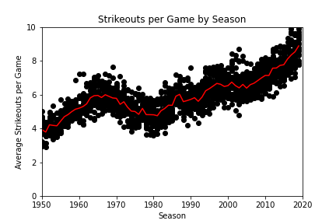
History
Over 70+ years of historical data in the MLB season.
More than 700,000 pitches are thrown in each season.
Strikeouts have risen significantly since 1980 and continue to increase.
An overview of how Strikeouts per game has changed based on significant events over the past 70 years.
Strike zone enlarged 1963-68
Designated hitter rule took effect
Mitchell report on steroids
Changes with Substance policy 2021 Season
Notes:
Consider talking about:
Founding
Dead-ball era
Rise in popularity
World War II era
Breaking the color barrier
Women in baseball
Expanding west, south and north
Pitching dominance and rule changes
New stadiums and artificial surfaces
Scandals and a changing game
https://archive.nytimes.com/www.nytimes.com/interactive/2013/03/29/sports/baseball/Strikeouts-Are-Still-Soaring.html

Slide 20
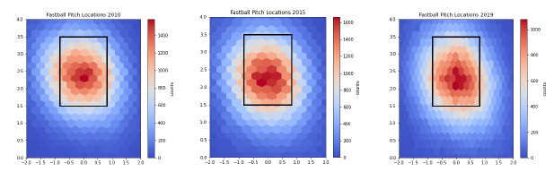
Analysis
The rise in strikeouts and homeruns can be attested to the way pitchers have gradually raised where they throw fastballs in the strike zone over the past 10 years.

Slide 21
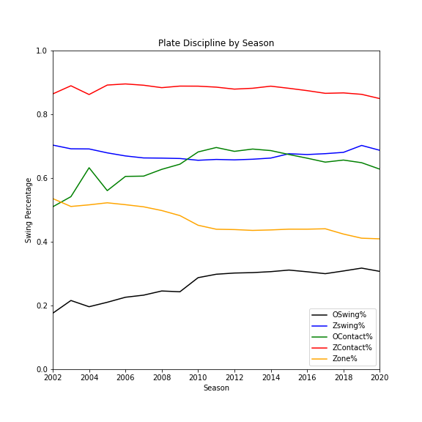
Analysis
Aggregated data on the players by year to determine how disciplined hitters are.
More pitches outside the zone = swinging at more pitches out of the zone.
Rising strikeouts and decreasing batting averages.
Pitchers are forcing hitters to swing at more pitches outside of the strike zone thus more strikeouts, lower batting average.
Notes:
After seeing how high the strikeout numbers and how low the batting averages are, we wanted to analyze the plate discipline metrics to determine if hitters are becoming more aggressive
As pitchers are throwing more pitches outside the zone it makes sense that hitters are responding by swinging at more pitches out of the zone.
It is interesting to note that at first the hitters were making more contact with pitches outside of the zone but in 2011, a downward trend begins.
Meanwhile, pitchers continued to throw a lower percentage of pitches in the zone, which aligns with the initial analysis of rising strikeouts and decreasing batting averages.
Question 4: Are hitters sacrificing plate discipline for the homerun?
After seeing how high the strikeout numbers and how low the batting averages are, we wanted to analyze the plate discipline metrics to determine if hitters are becoming more aggressive or more patient at the plate.
We found that the in the zone contact percentages remained relatively stable but had a slight decline start in 2016. The in the zone swing percentages was stable as well with values hovering at ~70%.
As pitchers are throwing more pitches outside the zone it makes sense that hitters are responding by swinging at more pitches out of the zone. It is interesting to note that at first the hitters were making more contact with pitches outside of the zone but in 2011, a downward trend begins. Meanwhile, pitchers continued to throw a lower percentage of pitches in the zone. These findings complement the initial analysis of rising strikeouts and decreasing batting averages. Pitchers are forcing hitters to swing at more pitches outside of the strike zone thus increasing the number of strikeouts and lower opposing hitters batting averages.

Slide 22

Learning Outcomes
Develop python scripts to access information from files of structured data, access files in semi-structured data, and to define and find patterns in unstructured data.
Prepare and transform data to produce data summaries, lists, and networks utilizing appropriate software packages that can be integrated into the problem solution.
Analyze and solve data access problems for the three types of data and to find and frame real world data questions and show how they can be answered with data.
The Scripting for Data Analysis course was essential in developing an understanding of the methods to utilizing various types of data to investigate complex problems.
The assignments and projects allowed for exploration into various python packages, as well as development of the knowledge to make use of the proper ones based on a given problem.
It is important to understand the versatility of Python and that there are many applications which allow one to write and run scripts to process, clean and analyze data.
Lastly, this course instilled habits to securely accessing data stored in various formats and for collaborating with colleagues using various software such as GoogleColab.
It is essential to gain the exposure to the tools and technologies used in a professional setting within the field.
Notes:
The Scripting for Data Analysis course was essential in developing an understanding of the methods to utilizing both structured and unstructured data to investigate complex problems. The assignments and projects allowed for exploration into various python packages, as well as development of the knowledge to make use of the proper ones based on the conditions of a given problem. It is important to understand the versatility of Python and that there are many applications which allow one to write and run scripts to process, clean and analyze data.
Another aspect of this course was to securely access data stored in various formats and collaborate with colleagues using various software such as GoogleColab. It is essential to gain the exposure to the tools and technologies used in a professional setting within the field.

Slide 23

Thank you!
To review these projects in detail as well as additional information about my studies in this Masters program please check out my GitHub and LinkedIn. I am always open for new connections and conversations!
Thank you for allowing me to walk you through my journey into data Science. To review these projects in detail as well as additional information about my studies in this master program please check out my GitHub and LinkedIn. I am always open for new connections and conversations!

